Slide 1
Presentation on
Schedules and Serializability
Concepts of locking for concurrency control
By: Arjun Adhikari

Slide 2
What are Transactions?
Set of Instructions which all run or none run.

Slide 3
Schedule
When multiple transactions are running concurrently then there needs to be a sequence in which the operations are performed because at a time only one operation can be performed on the database. This sequence of operations is known as Schedule.
Basically, the sequence in which transactions are performed is governed by schedule.

Slide 4
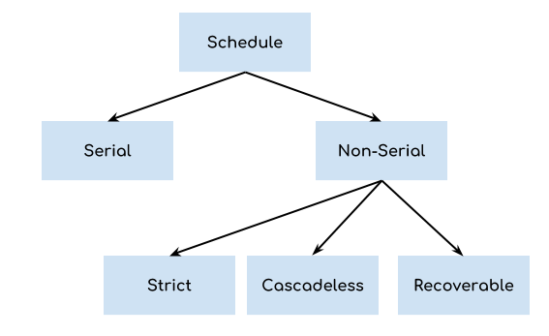
Types of Schedule

Slide 5
Types of Schedule
Serial Schedule
In Serial schedule, a transaction is executed completely before starting the execution of another transaction. In other words, you can say that in serial schedule, a transaction does not start execution until the currently running transaction finished execution. This type of execution of transaction is also known as non-interleaved execution.

Slide 6
Non Serial Schedules
Non Serial Schedules are of 3 types:
Strict
Cascadeless
Recoverable
Strict Schedule
In Strict schedule, if the write operation of a transaction precedes a conflicting operation (Read or Write operation) of another transaction then the commit or abort operation of such transaction should also precede the conflicting operation of other transaction.

Slide 7
Non Serial Schedules
Cascadeless Schedule
In Cascadeless Schedule, if a transaction is going to perform read operation on a value, it has to wait until the transaction who is performing write on that value commits. A commit represents completion of a transaction.

Slide 8
Non Serial Schedules
Recoverable Schedule
In Recoverable schedule, if a transaction is reading a value which has been updated by some other transaction then this transaction can commit only after the commit of other transaction which is updating value.

Slide 9
Concurrency Control
Concurrency Control in Database Management System is a procedure of managing simultaneous operations without conflicting with each other. It ensures that Database transactions are performed concurrently and accurately to produce correct results without violating data integrity of the respective Database.

Slide 10
Example of Concurrency Control Necessity
Assume that two people who go to electronic kiosks at the same time to buy a movie ticket for the same movie and the same show time.
However, there is only one seat left in for the movie show in that particular theatre. Without concurrency control in DBMS, it is possible that both moviegoers will end up purchasing a ticket. However, concurrency control method does not allow this to happen. Both moviegoers can still access information written in the movie seating database. But concurrency control only provides a ticket to the buyer who has completed the transaction process first.

Slide 11
Concurrency Control Protocols
Lock-Based Protocols
Two Phase Locking Protocol
Timestamp-Based Protocols
Validation-Based Protocols

Slide 12
Lock-based Protocols
Lock Based Protocols in DBMS is a mechanism in which a transaction cannot Read or Write the data until it acquires an appropriate lock. Lock based protocols help to eliminate the concurrency problem in DBMS for simultaneous transactions by locking or isolating a particular transaction to a single user.
A lock is a data variable which is associated with a data item. This lock signifies operations that can be performed on the data item.
All lock requests are made to the concurrency-control manager. Transactions proceed only once the lock request is granted.

Slide 13
Types of Locks
Binary Locks: A Binary lock on a data item can either locked or unlocked states.
Shared/exclusive Locks
Shared Lock(S)
Exclusive Lock (X)
Simplistic Lock
Preclaiming Lock

Slide 14
Shared Lock
A shared lock is also called a Read-only lock. With the shared lock, the data item can be shared between transactions. This is because you will never have permission to update data on the data item.
For example, consider a case where two transactions are reading the account balance of a person. The database will let them read by placing a shared lock. However, if another transaction wants to update that account's balance, shared lock prevent it until the reading process is over.

Slide 15
Exclusive Lock
With the Exclusive Lock, a data item can be read as well as written. This is exclusive and can't be held concurrently on the same data item. X-lock is requested using lock-x instruction. Transactions may unlock the data item after finishing the 'write' operation.
For example, when a transaction needs to update the account balance of a person. You can allows this transaction by placing X lock on it. Therefore, when the second transaction wants to read or write, exclusive lock prevent this operation.

Slide 16
Simplistic Lock Protocol
This type of lock-based protocols allows transactions to obtain a lock on every object before beginning operation. Transactions may unlock the data item after finishing the 'write' operation.

Slide 17
Pre-claiming Locking
Pre-claiming lock protocol helps to evaluate operations and create a list of required data items which are needed to initiate an execution process. In the situation when all locks are granted, the transaction executes. After that, all locks release when all of its operations are over.

Slide 18
Starvation and Deadlock
Starvation
Starvation is the situation when a transaction needs to wait for an indefinite period to acquire a lock.
Following are the reasons for Starvation:
When waiting scheme for locked items is not properly managed
In the case of resource leak
The same transaction is selected as a victim repeatedly.
Deadlock
Deadlock refers to a specific situation where two or more processes are waiting for each other to release a resource or more than two processes are waiting for the resource in a circular chain.

Slide 19
The End

